Slide 1

Nick Perkins, Arunn Chanthirakanthan, Brian Wolf,
David Hudson, Gianluca Bastia

Slide 2

Why Voluntold?
Provide an easy resource for volunteers
Encourage people to be more active
Create stronger & closer communities
Mission statement:
“To bring communities together through shared projects, interests and ideas.”

Slide 3
Usability
Clean and sleek design
Portable--fits desktop and mobile browsers
Simple Signup Process
Provides 3 simple filters to search for events
Keyword
Date
Location
Google Maps for easy, readable display

Slide 4
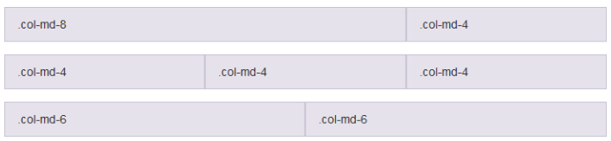
Bootstrap
HTML, CSS and Javascript framework for web design
Developed by Twitter employees
Consistent design
Uses a grid layout to scale a web application to fit on all devices and resolutions
Notes:
Twitter - very user friendly

Slide 5
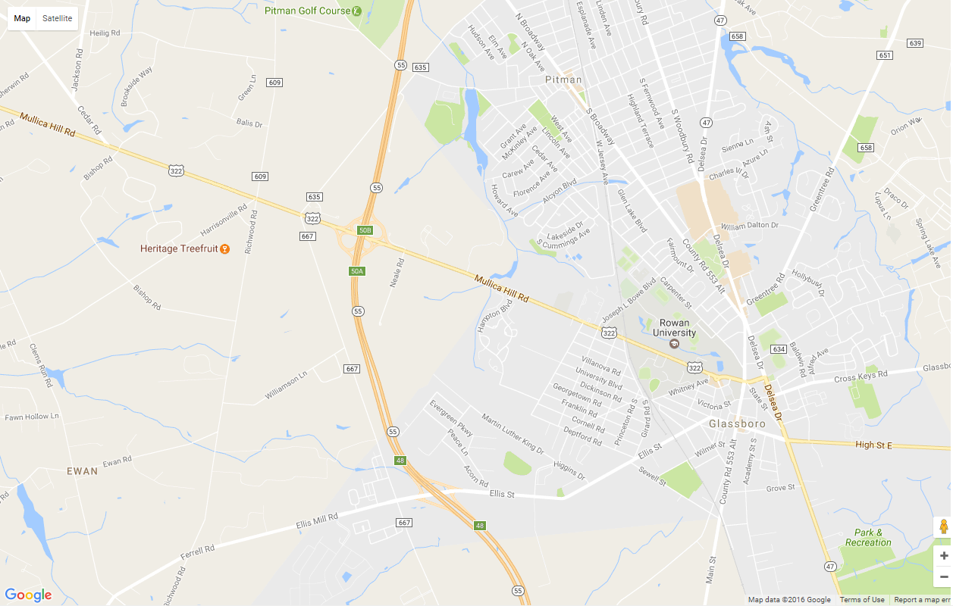
Location Services
Google Maps Functionality
Google Maps API
Geocoding API

Slide 6
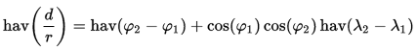
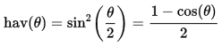
Google Maps API
Used to display event location information
initMap() function to declare/initialize map with center & zoom
Places markers for events
Markers display event information
User can search for events
By Name
By Date
By Location
Takes an address and user-specified radius
Haversine Formula (Great Circle Distance)
φ (phi) = latitude
λ (lambda) = longitude

Slide 7

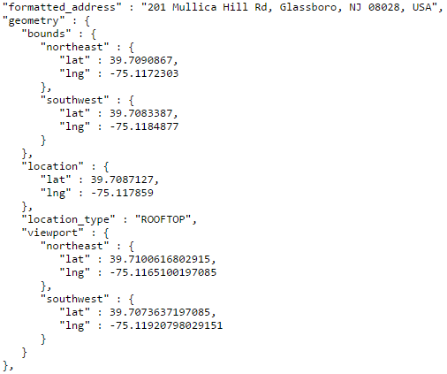
Geocoding API
Google Maps Geocoding API
Converts an address into latitude and longitude coordinates
Uses HTTP interface
Request is a URL:
Returns coordinates:

Slide 8
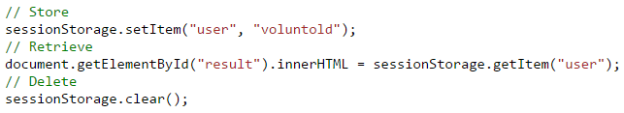
sessionStorage
Stores structured data on the client side
Supported by HTML5 Storage
Similar to localStorage but stores data for one session & allows multiple sessions
Uses Key/Value pairs

Slide 9
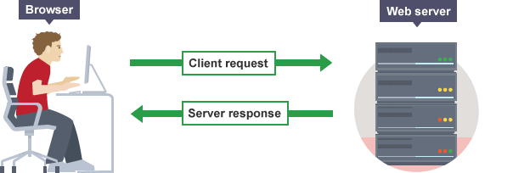
REST API
JavaScript/JQuery -> AJAX
REST api
GET
POST
PUT
DELETE
Endpoints & JSON data

Slide 10

Backend Server
REST api
Built on Java
Runs locally on a Jetty Server
Packaged as a runnable jar

Slide 11
Spark
Simple and lightweight Java web framework built for rapid development
Java 8's lambda philosophy
No XML configuration files!
Can serve JSON data in less than 10 lines of code
import static spark.Spark.*; public class HelloWorld { public static void main(String[] args) { get("/hello", (req, res) -> "Hello World"); } }
http://sparkjava.com/

Slide 12
JSON Parsing
GSON
Open source Google project
Provided simple ways to convert toJson() and fromJson()
Allows custom JSON to POJO (Plain Old Java Object)
Uses reflection--no special serialization or class modification needed
Uses java.lang.Class to change the class at runtime

Slide 13
Demo

Slide 14
Questions?

Slide 15

Landmark
After the last presentation

